Slide 1
Funding successful projects on Kickstarter
by
- Kowshik Balaji Thiagarajan
- Charon Guo
- Ronnie Li

Slide 2
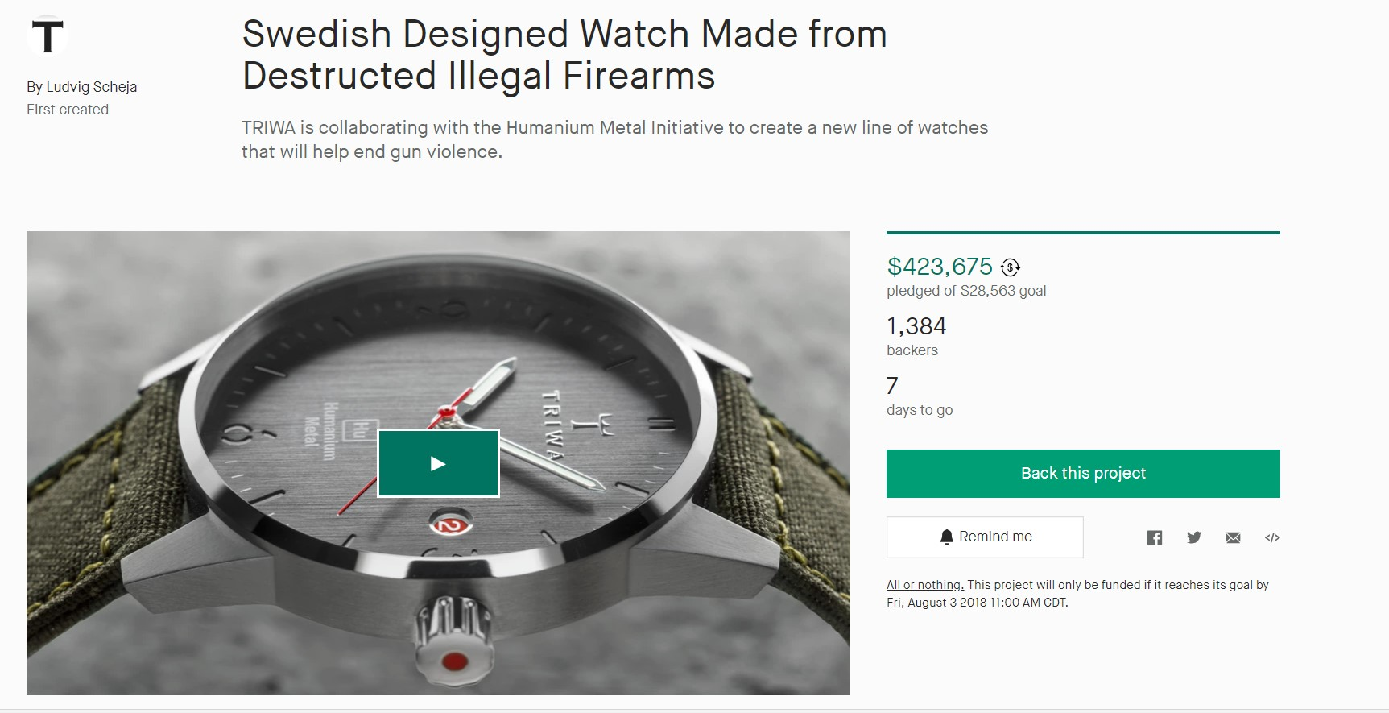
What is Kickstarter?
A crowd-funding platform

Slide 3
Simple formula of Kickstarter
Reach goal amount on time = Success

Slide 4
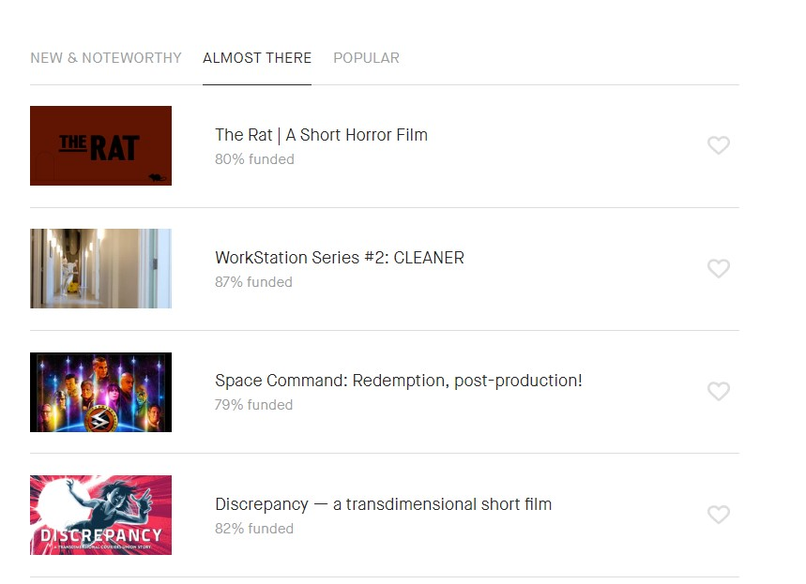
Which one is more likely to reach the target?

Slide 5
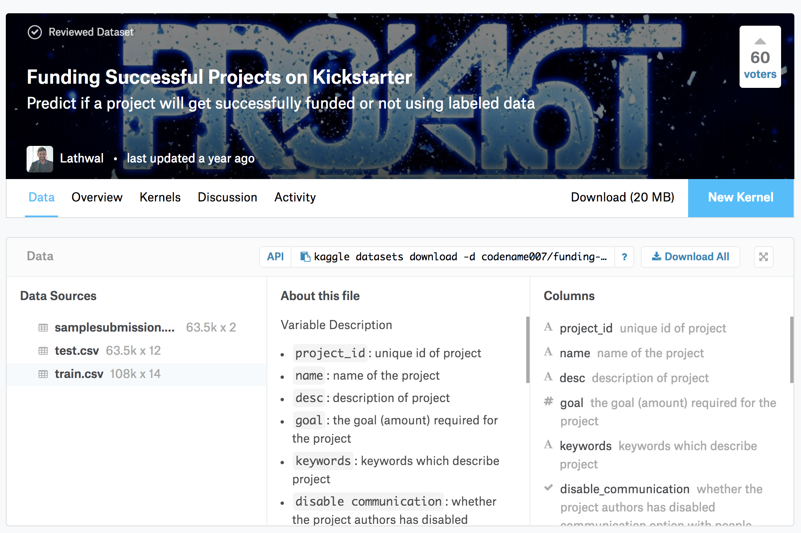

Slide 6
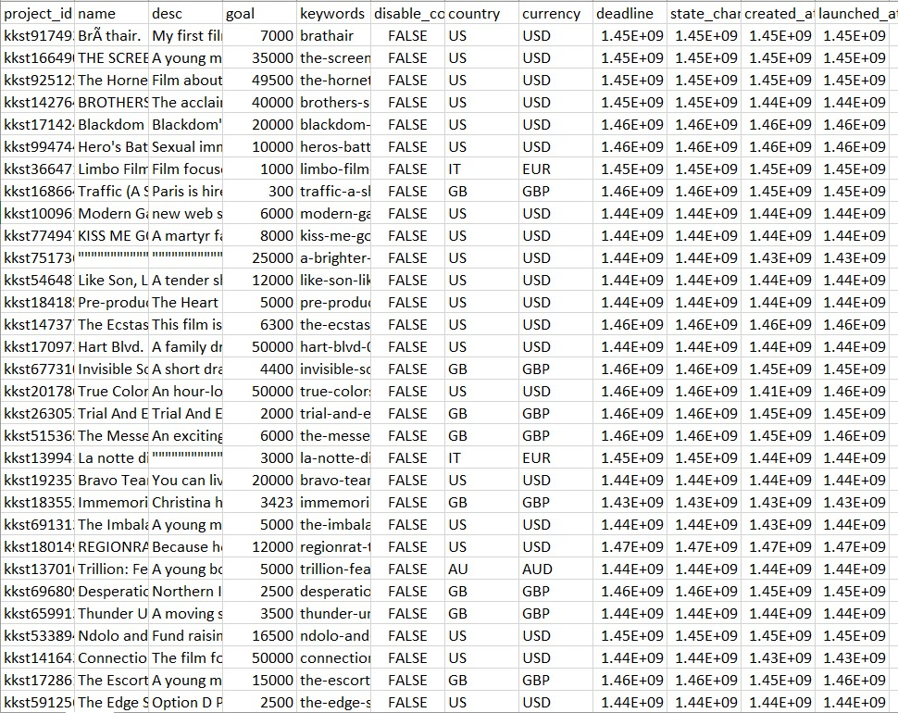
2009-2015 from Kaggle

Slide 7
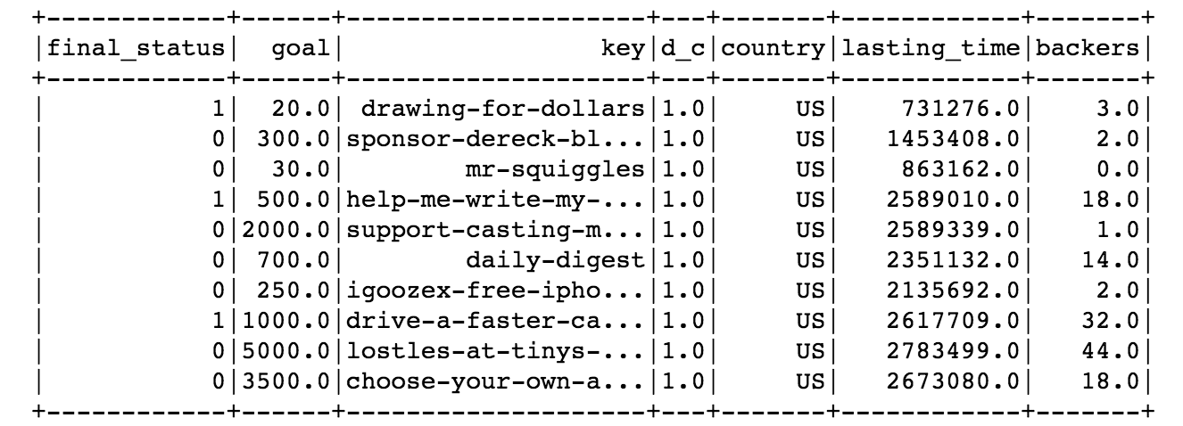

Slide 8


Process
Evaluate Model
Import Data
Split Data
Accuracy
ROC (Receiver Operating Characteristic)
PR (Precision Recall)
70% : 30%
​
Build/Run Model
The Higher, The Better!
Clean Data
TF-IDF(Term frequency -inverse document frequency)
||
A vectorization method to reflect the importance of a term to a document.
Random Forest
Decision Tree
Logistic Regression
Naïve Bayes
Remove Redundant
Integration
Transformation (string -> vector)
=> TF-IDF

Slide 9
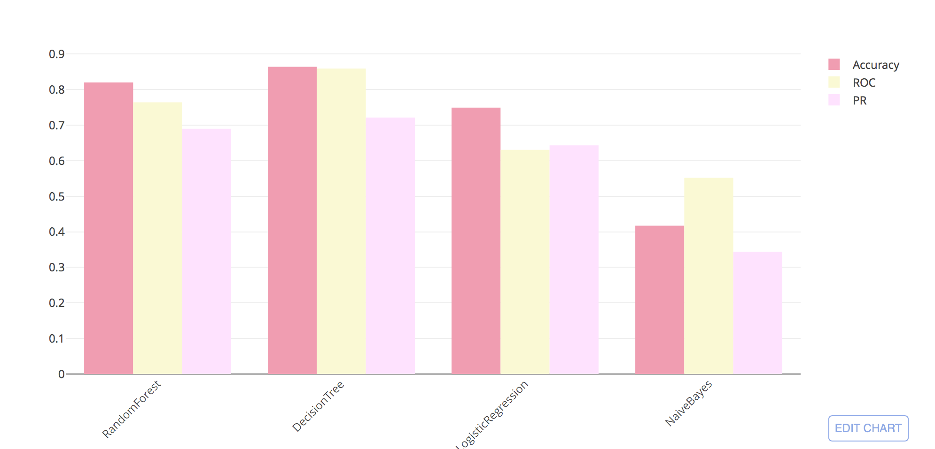
Result Analysis
4 models applied
Best Solution
Decision Tree Model
Test Error = 0.138458
Accuracy = 0.861542
Test ROC = 0.854186
Test PR = 0.720009

Slide 10
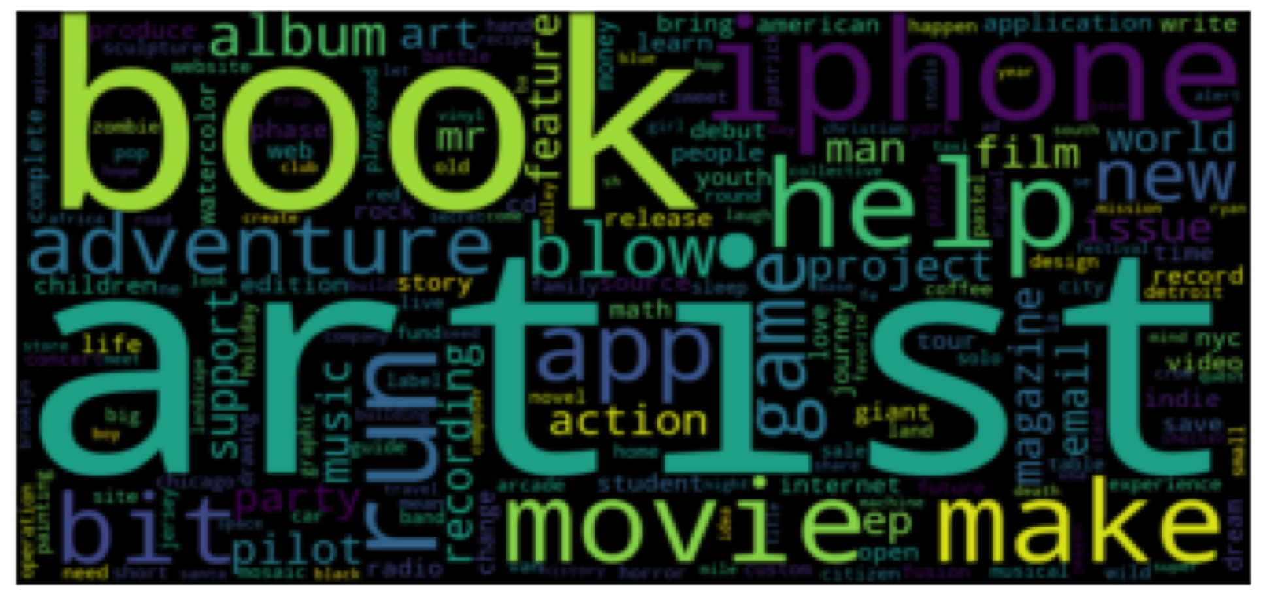
Word Cloud

Slide 11
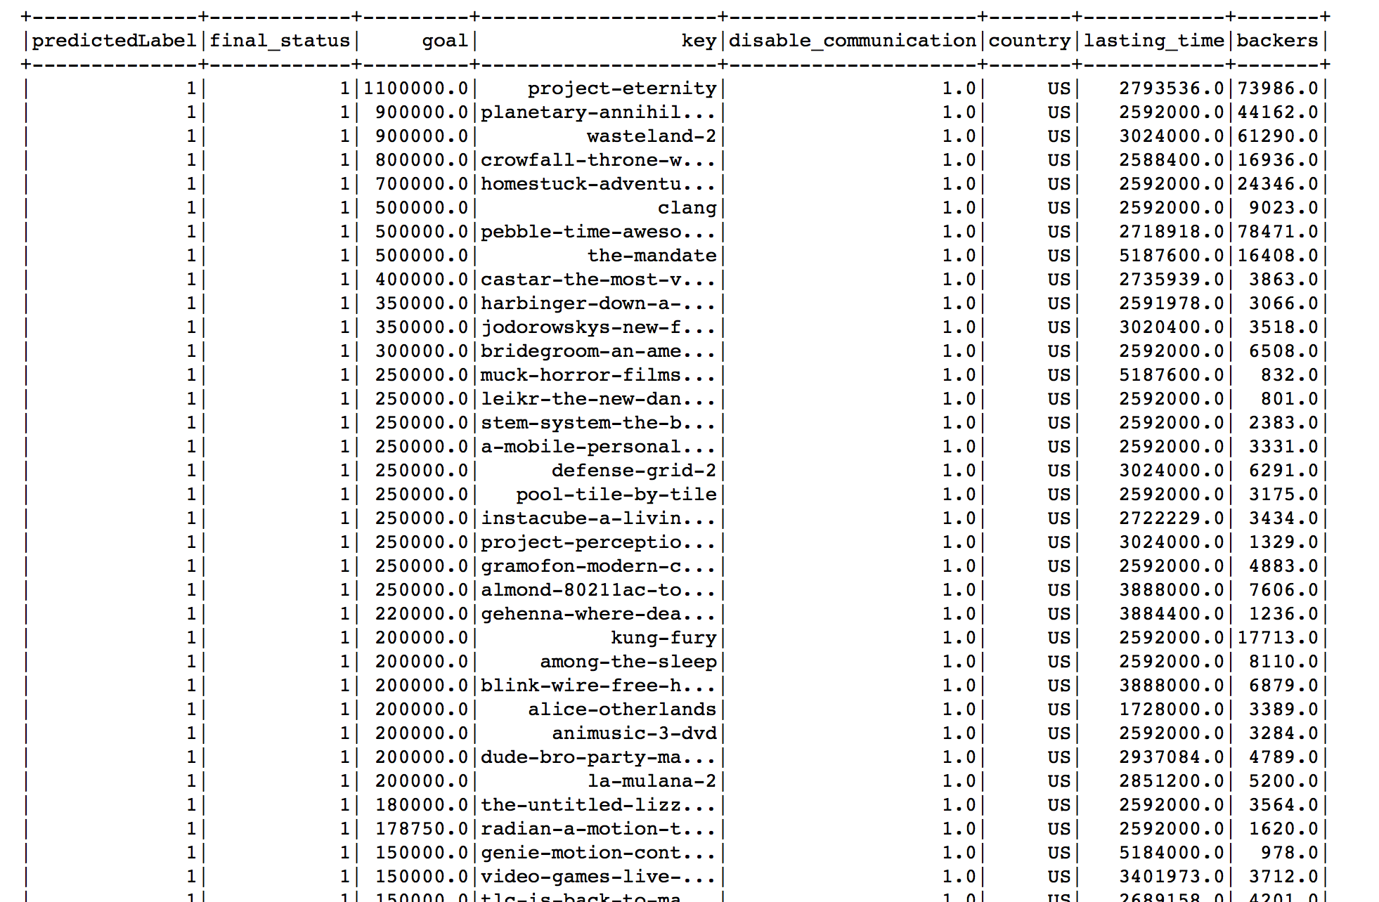
Top 50 Successful Project

Slide 12
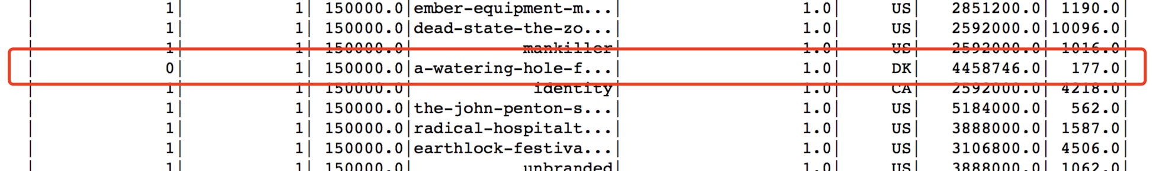
One of the Main factor: --Backers

Slide 13
Application of the Model:
Venture Capitalists
Angel Investors
P2P Companies
…

Slide 14
Thank You For Listening! ☺
Any questions?
Jun Akizaki – The Power of PowerPoint
Used Font: Roboto, Clear Sans

